Slide 1

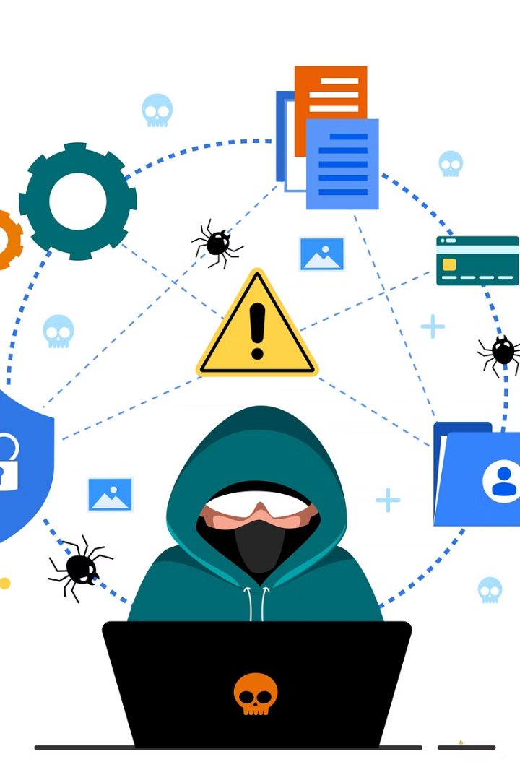

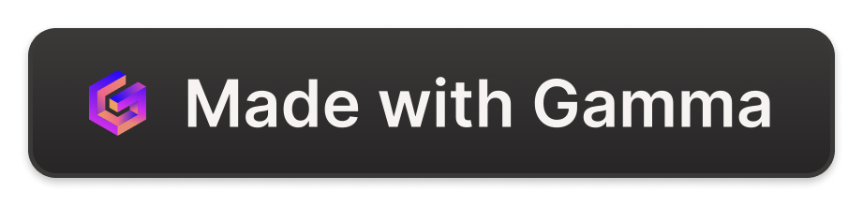
Detecting Data Leaks Using SQL
This capstone project report details the development of a cloud-based system designed to detect data leaks and protect user information on e-commerce platforms. The system utilizes advanced content inspection and contextual analysis, along with AESX encryption, to identify and mitigate potential security threats.
by Shaik Hanifa

Slide 2
Define what a data leak is: "A data leak occurs when sensitive information is accidentally or intentionally exposed.“
Detecting data leaks is crucial for protecting privacy and maintaining trust. When sensitive information is exposed, it can lead to identity theft, financial loss, and damage to an organization's reputation. By identifying and addressing data leaks quickly, we can safeguard personal information, uphold customer trust, and comply with legal and regulatory requirements. This proactive approach helps prevent potential breaches and fosters a secure environment for both individuals and organizations.

Slide 3
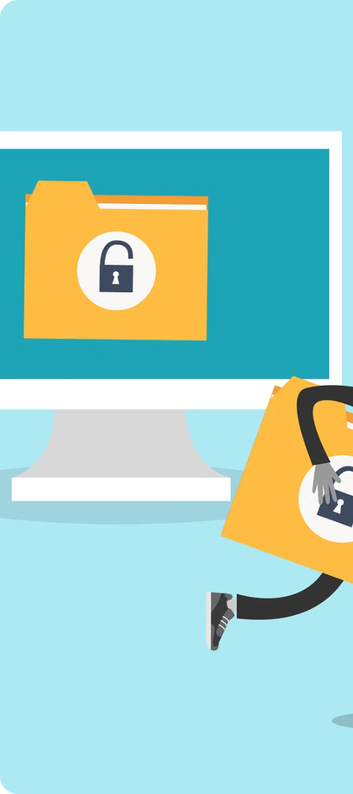
Problem Statement
Data Breaches
Insufficient Security
Data breaches are a growing concern, compromising the privacy and security of individuals' personal information, especially on e-commerce platforms.
Current security measures often fail to prevent password theft, keystroke logging, and ransomware attacks, leaving users vulnerable.
Need for Robust System
There is a pressing need for a system that can effectively detect and mitigate these security threats to protect users' personal and financial information.

Slide 4
Requirements Gathering
1
User Authentication and Authorization
2
Data Encryption
Utilize AESX encryption for data storage and transmission, ensuring all sensitive user data is encrypted both at rest and in transit.
Implement robust user authentication mechanisms (e.g., multi-factor authentication) and define different user roles and permissions.
3
Content Inspection and Contextual Analysis
4
Data Loss Prevention (DLP) Measures
Identify and flag messages or actions that pose security risks, implementing automatic restrictions or alerts for flagged users.
Develop algorithms to inspect and analyze user messages and behaviours in real-time, implementing machine learning models to classify users based on their online activities.

Slide 5
WHY SQL
Widely Used: SQL (Structured Query Language) is the standard language for managing and manipulating databases, used by most organizations worldwide.
Efficient Data Querying: SQL allows for quick and efficient querying of large datasets, making it easier to identify patterns and anomalies.
Powerful Analysis: SQL’s advanced functions enable detailed data analysis, crucial for detecting unusual activities that might indicate a data leak.
Accessibility: SQL is relatively easy to learn and use, with a vast amount of resources available for training and support.
Integration: SQL integrates well with various tools and platforms, enhancing its capability to monitor and analyze data across different systems.
Using SQL to detect data leaks leverages these strengths, making it an effective tool for maintaining data security and integrity.

Slide 6
Choose Cloud Provider
AWS
Security Features
Scalability and Performance
Amazon Web Services (AWS) emerges as the most suitable cloud provider due to its comprehensive security features, scalability, performance, integration capabilities, and cost-effectiveness.
AWS offers robust encryption solutions, compliance with various security standards, and advanced identity and access management.
AWS provides elastic compute resources, global reach, and scalable storage solutions, ensuring high performance and reliability.

Slide 7
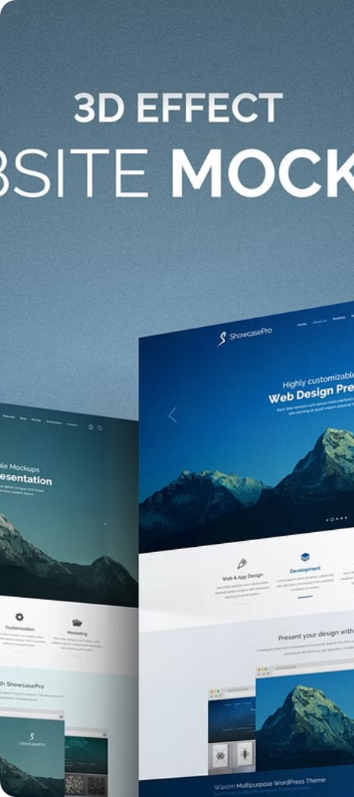
Develop Frontend
1
Layout
A well-structured and intuitive layout is crucial for providing an excellent user experience, ensuring easy navigation and quick access to essential features.
2
User-Friendly Design
Creating a user-friendly design involves focusing on ease of use, accessibility, and a seamless user experience.
3
Color Selection
Choosing the right color scheme is essential for creating an aesthetically pleasing and functional interface, ensuring readability, accessibility, and a professional look.

Slide 8
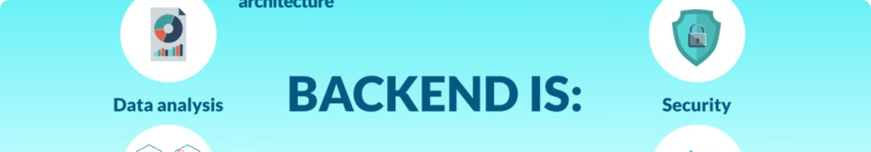



Develop Backend
Database Implementation
Execution
Core Services and Modules
A robust and scalable database is essential for storing and managing data related to user activities, security incidents, and system configurations.
The backend framework and environment will be Node.js with Express.js for the web server, deployed on AWS for infrastructure.
Implement core services such as authentication service, user service, activity logging service, security incident service, and notification service.

Slide 9
Implementation and Integrate with Cloud Services
Backend Implementation Steps
Frontend Implementation Steps
Set Up Development Environment
Set Up Frontend Development Environment
Develop Backend Components
Design and Develop UI Components
Integrate with External Services
Integrate with Backend APIs

Slide 10




Performance Evaluation
Response Time
Throughput
Scalability
Resource Utilization
Measure the time taken for the system to respond to user requests.
Measure the number of requests processed per unit of time to assess system capacity.
Assess the system’s ability to handle increasing workload by scaling resources.
Monitor resource consumption (CPU, memory, disk I/O) to optimize efficiency and cost-effectiveness.

Slide 11
REAL TIME SCENARIO
Real-Life Example: Detecting a Data Leak with SQL
A company noticed an unusual amount of data being accessed from their database. To investigate, they used SQL to
analyze their access logs.
Steps Taken:
1. Identify Unusual Access Patterns:
- The company ran an SQL query to count how many times each user accessed sensitive files within a specific period.
sql.
SELECT user_id, COUNT(*) AS access_count
FROM access_logs
WHERE access_time BETWEEN '2024-06-01' AND '2024-06-30'
GROUP BY user_id
HAVING COUNT(*) > 100;
2. Analyze Results:
- The query results showed that one user, `user123`, accessed sensitive files 150 times in June, which was
significantly higher than the average of 20 accesses per user.
3. Further Investigation:
- To understand the context, they ran another query to see the specific files accessed by `user123`.
```sql
```

Slide 12
SELECT file_name, access_time
FROM access_logs WHERE user_id = 'user123' AND access_time BETWEEN '2024-06-01' AND '2024-06-30';
4.Findings:
The detailed log showed that user123 had accessed files containing personal customer information multiple times late at night, which was unusual for their role and work hours.
Outcome:
Detected a Data Leak: The analysis revealed that user123 was accessing sensitive information without authorization, indicating a potential data leak.
Took Action: The company immediately restricted user123's access, conducted a security audit, and implemented stricter access controls to prevent future incidents.
By using SQL to analyze access patterns and identify anomalies, the company was able to detect and respond to a data leak promptly, protecting their sensitive information and maintaining trust with their customers.

Slide 13


